Slide 1




Diwali
Sales Analysis
In Python

Slide 2

OVERVIEW
DATA UNDERSTANDING
DATA CLEANING
Project Recape
Topics
EXPLORATORY DATA ANALYSIS
INSIGHTS
CONCLUSION

Slide 3

Overview
Conducted in-depth analysis of Diwali Sales data, leveraging Python for Exploratory Data Analysis.
Derived actionable insights from comprehensive charts and graphs, enabling data-driven decision-making.

Slide 4
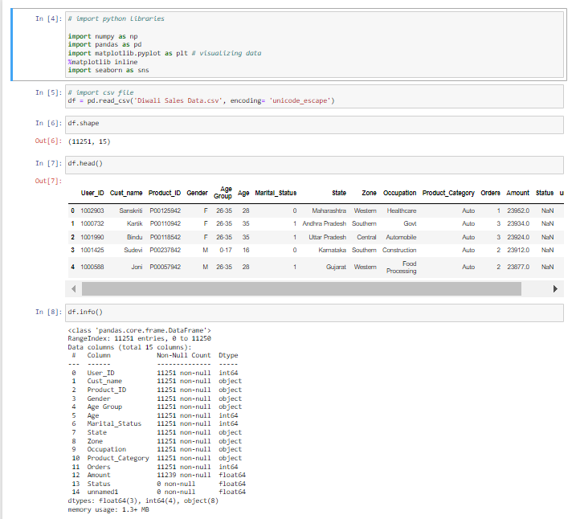
Data Undertanding
Reading and Cleaning of Data in Python

Slide 5
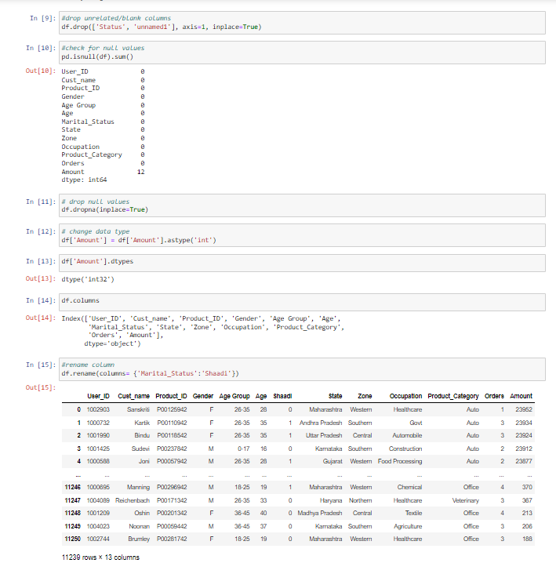
Data Cleaning

Slide 6
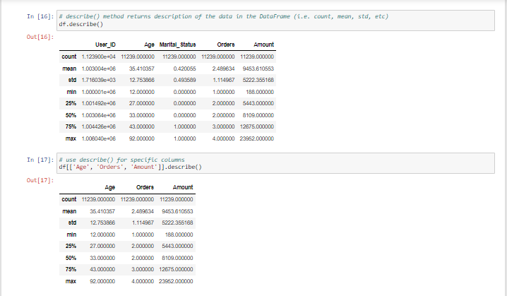
Data Cleaning

Slide 7
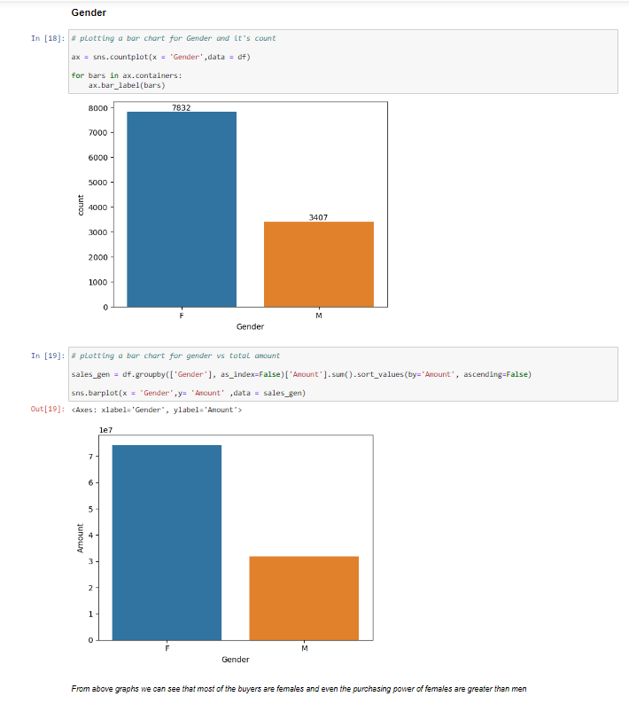
Exploratory Data
Analysis

Slide 8
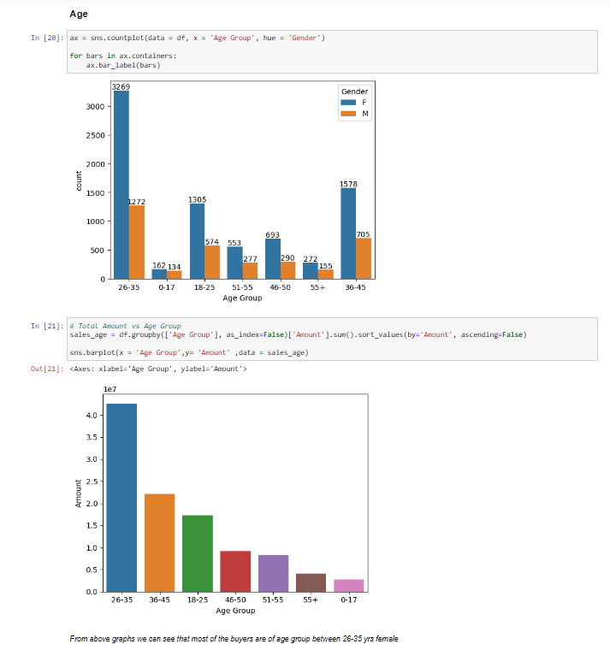
Exploratory Data
Analysis

Slide 9
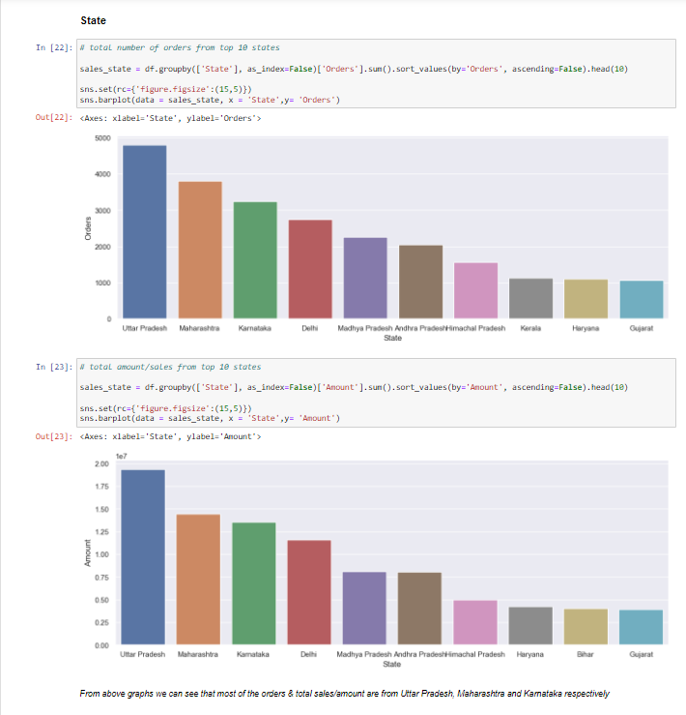
Exploratory Data
Analysis

Slide 10
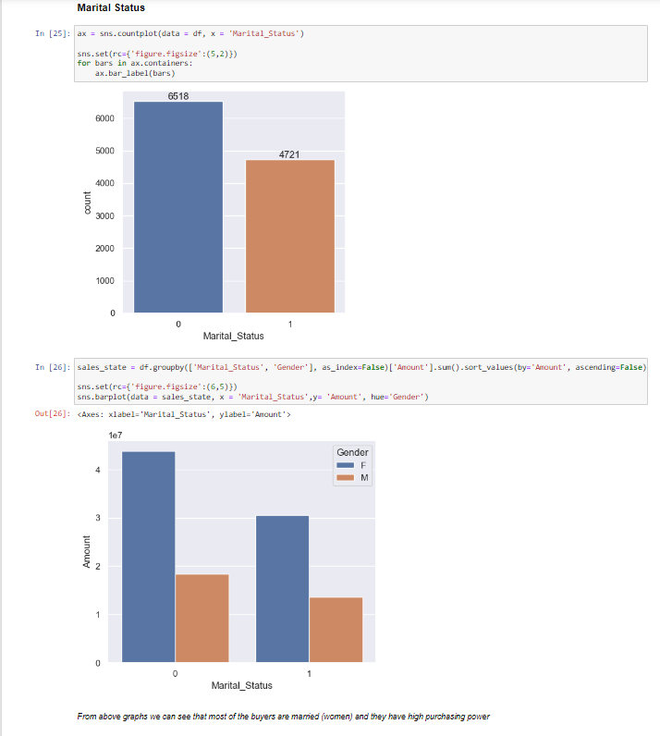
Exploratory Data
Analysis

Slide 11
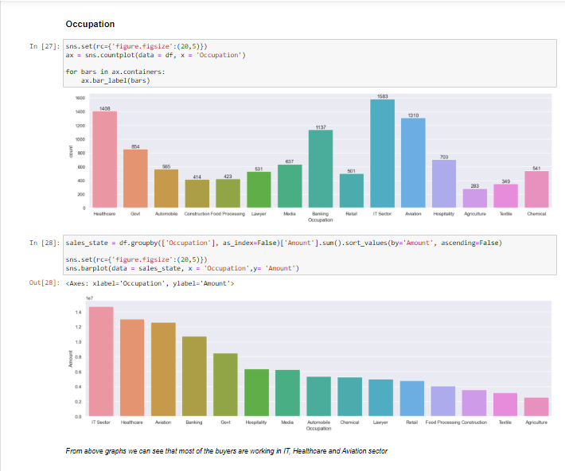
Exploratory Data
Analysis

Slide 12
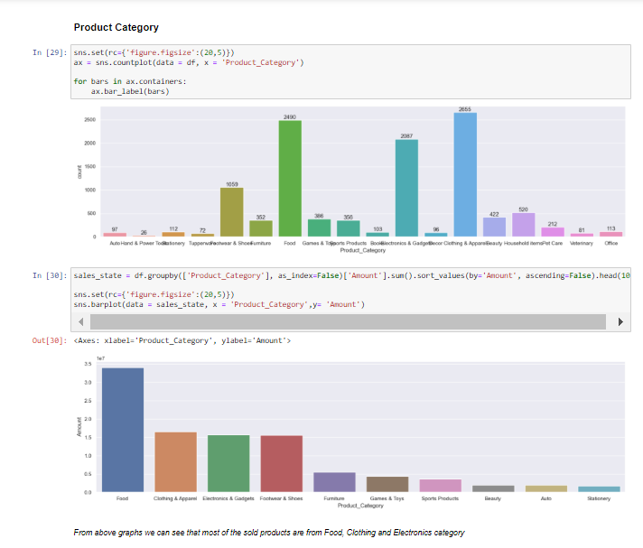
Exploratory Data
Analysis

Slide 13
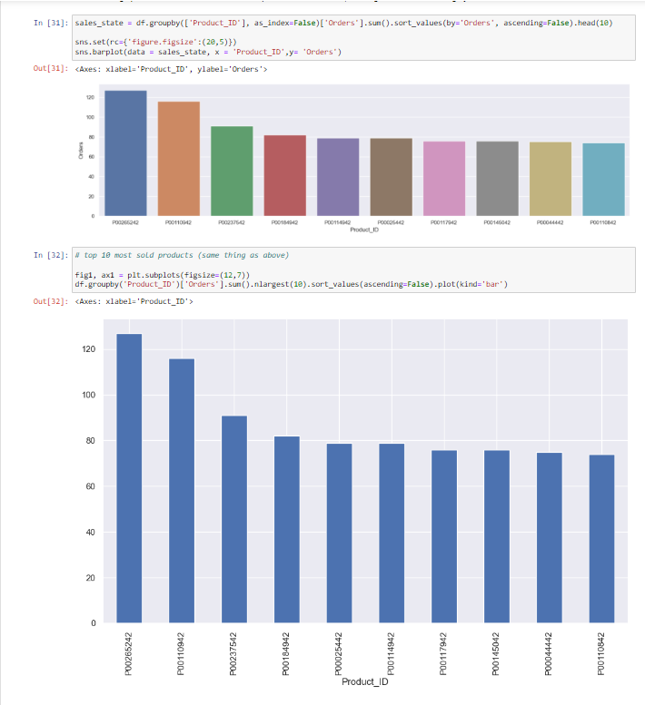
Exploratory Data
Analysis

Slide 14
Insights
Most of the buyers are females and even the purchasing power of females are greater than men
Most of the buyers are of the age group between 26-35 yrs female
Most of the orders & total sales/amount are from Uttar Pradesh, Maharashtra and Karnataka respectively
Most of the buyers are married (women) and they have high purchasing power
Most of the buyers are working in the IT, Healthcare and Aviation sector
Most of the sold products are from Food, Clothing and Electronics category

Slide 15
Conlusion
Married women age group 26-35 yrs from UP, Maharastra and Karnataka working in IT, Healthcare and Aviation are more likely to buy products from Food, Clothing and Electronics category

Slide 16
Thank You!

